Slide 1
CUDA
Let’s get our hand dirty

Slide 2
How can we write code for GPUs?
We write our programs typically in C/C++
We use a special compiler, supplied by the video card maker (nvcc, for CUDA).
We use some keywords specific to this compiler (not standard C/C++).
The compiler writes X64 code for our CPU code and an intermediate format that the GPU will understand.

Slide 3
C/C++ Source Code with CUDA extensions
Compile Model
NVCC Compiler
X86/X64
Compiled Code
Byte Code for
GPU device
Executable File

Slide 4
X86/X64
Compiled Code
Byte Code for
GPU device
Execution Model
Executable File
RAM
CPU
GPU
PCI Express

Slide 5
Execution Model
CPU
GPU
PCI Express
Byte Code
Data
Results

Slide 6
What can I do in the kernels?
The GPU is not the CPU, so you cannot call most C functions (like printf) or operating system functions (like open).
Kernels are, essentially, for massively parallel math problems.
The parallelism is implicit - your code will automatically be run on many cores.

Slide 7
Function Declarations (in CUDA)
__device__ void func1() {} // run on the GPU, called from the GPU
__global__ void func2() {} // run on the GPU, called by the CPU
__host__ void func3() {} // run on the CPU, called only by the CPU
__host__ is the default and is not necessary, unless:
__host__ __device__ void func4() {} // the compiler will generate 2 different copies – one for the CPU and one for the GPU!
Note that you cannot call the CPU from the GPU!

Slide 8
Mapping the problem
Remember that GPUs were originally designed for 3d graphics
We have to convert our mental model of computation to something resembling 3d graphics
We can’t just say “here is a 10,000 item array” – we must reshape the problem so that it looks more like 3d graphics.

Slide 9
Grids, blocks and threads
When we call our GPU function, we can tell it the “geometry” of the problem.
We can specify the number of threads. This is limited to a max of 1024 threads. This is because they are all running on the same GPU and must share resources.
But we can specify multiple blocks. Each block consists of that number of threads (arranged in 1d, 2d or 3d, your choice!).
These blocks can be pictured in a single grid.

Slide 10
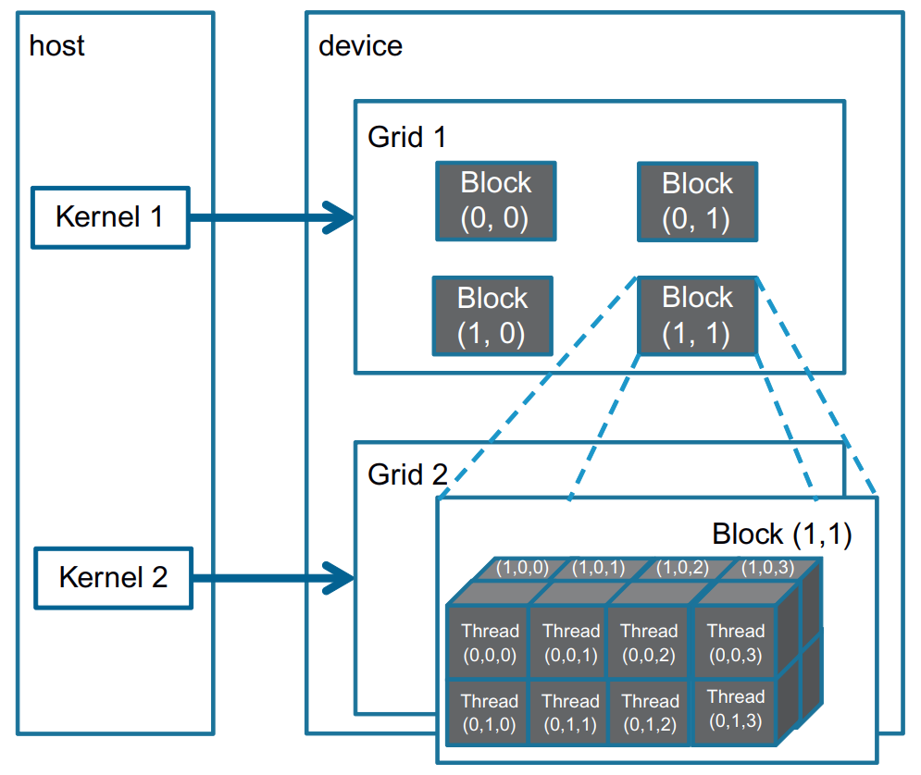
2D block arrangement
Remember you can decide 1d/2d/3d arrangements for all of these!
3D thread arrangement

Slide 11
Defining the thread/block structure
Remember that our GPU code looks like a C function.
When we call that function, we can specify the GPU configuration that we want.
MyGPUFunction<<<blocksInGridConfiguration, threadsInBlockConfiguration>>> (param1, param2, …);

Slide 12
thread/block examples
MyFunc<<10,1000>> (A,B,C); // 1000 threads/block, 10 blocks (1D)
dim3 threadsPerBlock(20,20); // 400 threads/block
dim3 blocksInGrid(100); // 100 blocks (1D)
MyFunc<<<blocksInGrid,threadsPerBlock>>>(A,B,C);
dim3 3dblocksInGrid(100,100,100); // 1 million blocks!
MyFunc<<<10,threadsPerBlock>>> (A,B,C);
MyFunc<<<M3dblocksInGrid,1000>>> (A,B,C);

Slide 13
Pre-declared variables
Inside your GPU-running functions, there are some variables that are predefined for you.
Because we are dealing with 3d, they are structures:
struct { int x; int y; int z;} // dim3!
dim3 threadIdx is the location of the thread in the block
dim3 blockIdx is the location of the block in the grid
dim3 gridDim is the configured size of the grid
dim3 blockDim is the configured size of the block
Remember:
A grid is a 1/2/3d array of blocks.
A block is a 1/2/3d array of threads.

Slide 14
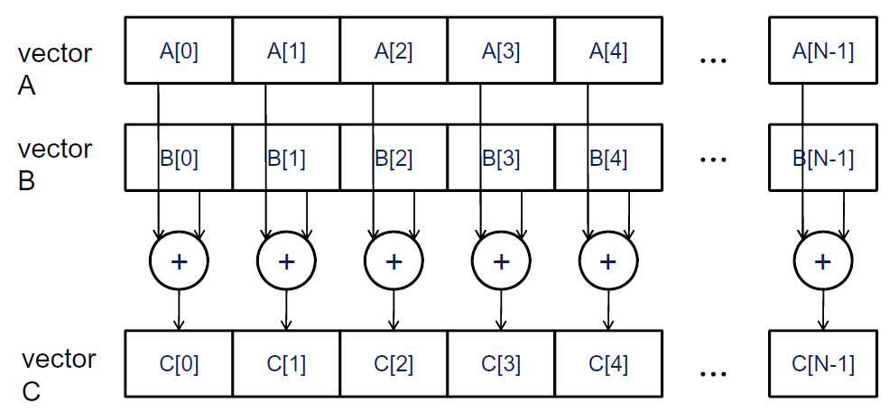
Example – add two vectors (arrays)

Slide 15
Example kernel code:
__global__ void addKernel(float *a, float *b, float *c, int n) {
int id = threadIdx.x + blockDim.x * blockIdx.x;
if (id < n) c[id] = a[id] + b[id];
}
Intended to be called as 1d blocks and a 1d grid.
n is the number of elements in the arrays; why?
What if the number of elements is not divisible by the grid/blocks?

Slide 16
Example demystified
If we ran this with 100 blocks (1d) and 1000 threads/block (1d):
<<<100,1000>>>
blockDim.x = 1000 (constant)
blockIdx.x = which block we are running in right now (0-99)
threadIdx.x = which thread inside the block we are running in (0-999)
Our overall thread id is blockIdx.x * blockDim.x + threadId.x

Slide 17
On the Host (CPU) side
We have to allocate space on the GPU. This gives us a pointer (!) that we can use to write data to the GPU.
There is a special version of malloc and memcpy for GPUs.
We allocate space for all of the data, then copy the source data over.
We “call” our __global__ function
We copy our results back to main memory
We free our gpu related memory

Slide 18
Calling CUDA (i.e. the host side)
#include <cuda.h>
void vecAdd(float* A, float* B, float* C, int n)
{ // assume that A,B,C are made and initialized elsewhere; normal C methodology
int size = n * sizeof(float);
float *gpu_A, * gpu_B, * gpu_C;
cudaMalloc((void **) &gpu_A, size);
cudaMemcpy(gpu_A, A, size, cudaMemcpyHostToDevice);
cudaMalloc((void **) &gpu_B, size);
cudaMemcpy(gpu_B, B, size, cudaMemcpyHostToDevice);
cudaMalloc((void **) &gpu_C, size);
// 256 threads/block, n/256 (round up) blocks needed
addKernel<<<ceil(n/256), 256>>>(gpu_A, gpu_B, gpu_C, n);
cudaMemcpy(C, gpu_C, size, cudaMemcpyDeviceToHost);
cudaFree(gpu_A); cudaFree(gpu_B); cudaFree(gpu_C);
}

Slide 19
Shouldn’t we check for errors?
Yes, we should! Space on the presentation makes this hard…
Every CUDA function does this the same way!
cuda_Error_t didItWork = cudaSomeFunction();
cudaSuccess is the value returned when a function worked.

Slide 20
A performance note…
Remember that all of the code is running the same program counter.
What happens when you have 2 threads, one where id < n and one where id > n?
The core that shouldn’t do the calculation pauses, waiting for the other cores in the warp to catch up.
Avoiding this is key to good GPU performance. Here, we don’t care, since the id>n cores have no work to do anyway.

Slide 21
Performance note continued
Consider, though:
if (id%2)
c[id] = a[id] + b[id];
else
c[id] = a[id] - b[id];
How will this perform?

Slide 22
How can we make it better?
factor = id%2 ? 1 : -1 ;
c[id] = a[id] + factor * b[id];
OR
b = id % 2 ? b[id] * 1 : b[id] * -1;
c[id] = a[id] + b;

Slide 23
Blur
So far, we have been considering kernels as if every data item was independent of every other data item.
What if they aren’t? For example – we want to perform vectorAdd. Then we want to make each result the average of itself and the vector value to the left and right (id of -1 and +1).
How can we ensure that all of the results are finished before we start averaging?

Slide 24
Synchronization
CUDA provides a convenient function that we can call from the GPU:
__syncthreads();
This will wait until all threads in the block have computed before continuing.

Slide 25
Why do we need synchronization?
Wasn’t the whole point that every thread has the same program counter?
Yes, but remember that our block could have more threads than our GPU has cores.
Synchronization makes sure that every thread in the block has run.

Slide 26
Example kernel code:
__global__ void blurKernel(float *a, float *b, float *c, int n) {
int id = threadIdx.x + blockDim.x * blockIdx.x;
if (id < n) c[id] = a[id] + b[id];
__syncthreads(); // c is calculated for this whole block
if (id < n) temp = c[id] + c[id+1] + c[id-1];
__syncthreads(); // temp is calculated for this whole block
if (id < n) c[id] = temp/3; // now it’s safe to change c
}
Note that we aren’t checking id+1/id-1 for safety…

Slide 27
Something a bit more complex
So far, our examples have been doing only the smallest amount of work – adding or averaging. This is a waste of GPU time – the time to transfer the data and read it back is greater than the gain from parallelism.
Let’s try something more complex – matrix multiplication.
One thing to note, here, is that we will not constrain ourselves to a[id] and b[id] when we consider c[id].

Slide 28
Matrix Multiply Kernel
__global__ void MatrixMult (float *a, float *b, float *c, int size) {
int row = blockIdx.y * blockDim.y + threadIdx.y;
int col = blockIdx.x * blockDim.x + threadIdx.x;
if ((row<size) && (col < size)) { // stay in bounds
float result = 0.0;
for (int i=0;i<size;i++)
result += a[row*size+i] * b[i*size + col];
c[row*size+col] = result;
}
}

Slide 29
Math Functions
As previously stated, you can’t call CPU functions from the GPU
However, there are many math functions that are pre-defined for you.
These include most of the “libm” math functions – trigonometric functions, square root, hypotenuse, truncation, rounding and more.

Slide 30
Finding out what capability is available
cudaGetDeviceCount(int *devCount);
-- Returns the number of CUDA capable devices
Useful for deciding not to run (count == 0) or looping over all devices
cudaSetDevice (int device);
-- chooses which CUDA device to run code on
cudaGetDeviceProperties(cudaDeviceProp *prop, int deviceNum);
-- Populates a structure of info about device #deviceNum
Useful for getting functional limits on the device

Slide 31
cudaDeviceProp
int maxThreadsPerBlock – we have been using 1024, but that can vary
int maxThreadsDim[3] – maximum dimensions for threads in a block
int maxGridSize[3] – maximum dimensions for blocks in a grid
char name[256] – a string identifying the device
and much, much more…

Slide 32
Conclusion
CUDA is an API to access massively parallel hardware.
Code is written in C/C++. A special compiler handles communication with the device.
The workflow is: copy data to device, “call functions” on the device, then copy the results back.
Understanding the architecture is critical for working effectively.

